Slide 1
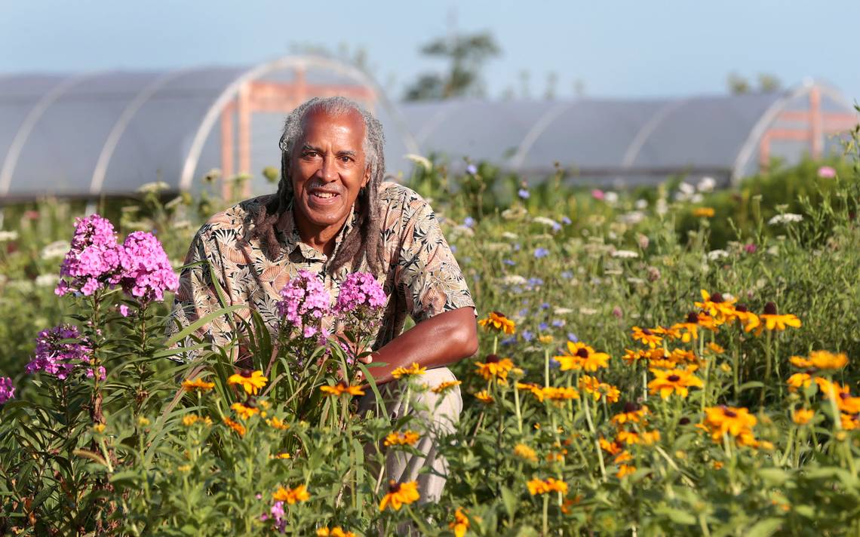
Greene Scholars- Summer Science Institute
Jim Embry
sustainlex.org
embryjim@gmail.com

Slide 2
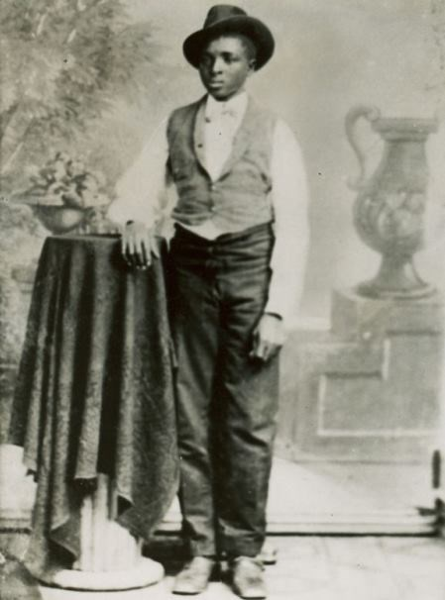

Slide 6
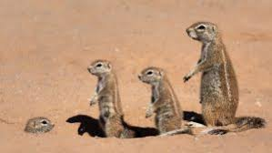
Small Groups
Peanut Group… Sweet Potato Group….Soybean Group Flower Group…Fungi Group
Questions:
How has NASA, David Robinson and others been inspired by Carver’s Legacy? Was Carver’s work significant enough to support the claim that he was one of the top scientists of his day?

Slide 7
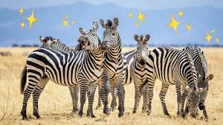
Small group report back

Slide 8
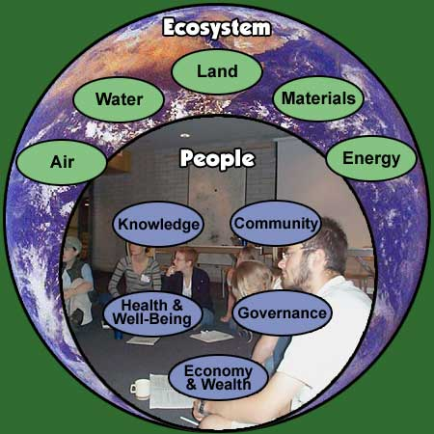
Our Global Ecosystem= Nature + People
Notes:
This diagrams places the Earth….our ecosystems as the foundation for our human endeavors…this drawing places people as subset of the larger whole…it affirms that our ability to manifest our humanity is dependent upon the health of the ecosystem Ecosystem=Nature + People…and we see that human civilization is a subset of the eco-system……

Slide 10
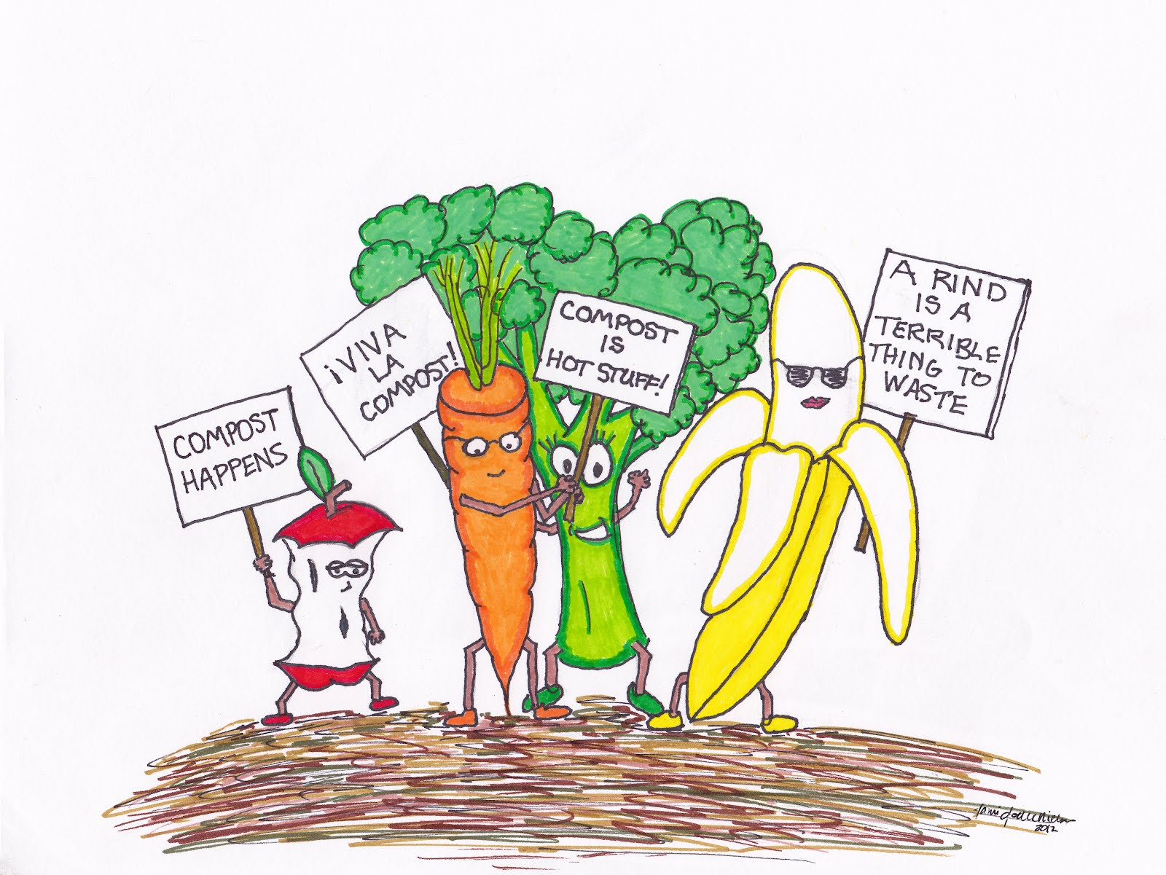

Slide 11
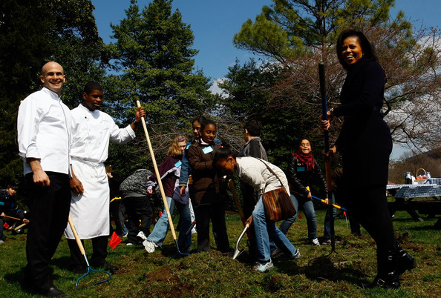

Slide 12
Life Principles
Zero waste
Simple living
Devotion to nature study
Healthy diets/soil
Local food
Organic food
Spiritual practice

Slide 13
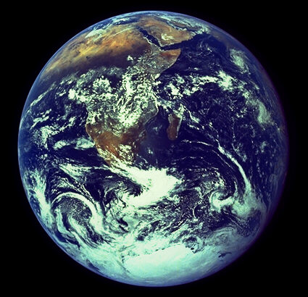
Ten Principles of One Planet Living

Slide 16
"He could have added fortune to fame, but caring for neither, he found happiness and honour in being helpful to the world."

Slide 17
It is a small
Leaders for a Sustainable Future

Slide 18
